Slide 1
Functions & Scoping
Department of Computer Science and Engineering
Chitkara University, Punjab

Slide 2
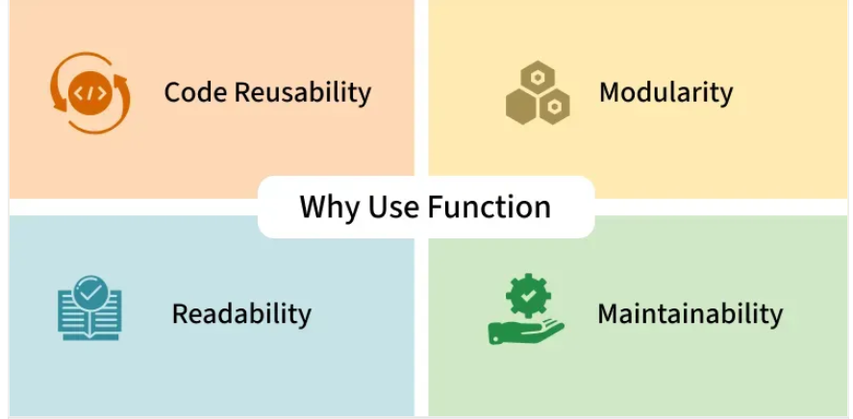
Functions in JavaScript
Functions in JavaScript are reusable blocks of code designed to perform specific tasks. They allow you to organize, reuse, and modularize code. It can take inputs, perform actions, and return outputs.

Slide 3
Syntax for Function Declaration:
function functionName(x, y) { statements... return (z) };
Syntax for Function Expression (anonymous):
let variableName = function(x, y) { statements... return (z) };
Syntax for Function Expression (named):
let variableName = function functionName(x, y)
{ statements... return (z) };
Syntax for Arrow Function:
let variableName = (x, y) => { statements... return (z) };

Slide 4
Understanding Functions
In functions, parameters are placeholders defined in the function, while arguments are the actual values you pass when calling the function
Example:
function greet(name) { // 'name' is a parameter
console.log("Hello " + name);
}
greet("Alice"); // "Alice" is the argument
Parameter → name (placeholder inside the function).
Argument → "Alice" (real value given at call time).

Slide 5
JavaScript Function Expression
The Javascript Function Expression is used to define a function inside any expression. The Function Expression allows us to create an anonymous function that doesn’t have any function name which is the main difference between Function Expression and Function Declaration.
A function expression can be used as an IIFE (Immediately Invoked Function Expression)which runs as soon as it is defined. A function expression has to be stored in a variable and can be accessed using variableName. With the ES6 features introducing Arrow Function, it becomes more easier to declare function expression

Slide 6
A function expression is a way to define a function by assigning it to a variable or using it within an expression, allowing the function to be stored, passed as an argument, or executed immediately.
Function expressions can be named or anonymous.
They are not hoisted, meaning they are accessible only after their definition.
Frequently used in callbacks, closures, and dynamic function creation.
Enable encapsulation of functionality within a limited scope.
const greet = function(name) {
return `Hello, ${name}!`;
};
console.log(greet("Steven"));

Slide 7
Passing a function as a parameter in JavaScript
In this, we will pass a function as a parameter in JavaScript. Passing a function as an argument to the function is quite similar to passing a variable as an argument to the function. So variables can be returned from a function.
The below examples describe passing a function as a parameter to another function.
Example 1: This example passes a function geeks_inner to the function geeks_outer as an argument.
function geeks_inner(value){
return 'hello User!';
}
function geeks_outer(func){
console.log(geeks_inner());
}
geeks_outer(geeks_inner);

Slide 8
Function Hoisting
What is Hoisting in JavaScript?
Hoisting is the default behavior in JavaScript where variable and function declarations are moved to the top of their respective scopes during the compilation phase. This guarantees that regardless of where these declarations appear within a scope, they can be accessed throughout that scope.
Features of Hoisting
Declarations are hoisted, not initializations.
Allows calling functions before their declarations.
All variable and function declarations are processed before any code execution.
Undeclared variables are implicitly created as global variables when assigned a value.

Slide 9
Function Hoisting
// Hoisting
function codeHoist() {
a = 10;
let b = 50;
}
codeHoist();
console.log(a); // 10
console.log(b); // ReferenceError : b is not defined

Slide 10
Function Hoisting- Example code
Javascript Nested functions In JavaScript, Functions within another function are called “Nested function.” These nested functions have access to the variables and parameters of the outer (enclosing) function, creating a scope hierarchy. A function can have one or more inner functions. | // Outer function function outerFunction() { // Nested function function nestedFunction() { // Function logic here } // Call the nested function nestedFunction(); // Rest of the outer function logic } // Call the outer function outerFunction();

Slide 11
What is Arrow Function?
What is Arrow Function?
An arrow function is essentially an anonymous function with a shorter syntax. They are often assigned to variables, making them reusable. Arrow functions are also known as lambda functions in some other programming languages.
Syntax
const gfg = () => {
console.log( "Hi Geek!" );
}

Slide 12
1. Arrow Function without Parameters
An arrow function without parameters is defined using empty parentheses (). This is useful when you need a function that doesn’t require any arguments.
Example: In this example we Defines an arrow function gfg without parameters that logs “Hi” when called.
const gfg = () => {
console.log( "Hi" );
}
gfg();
Output
Hi

Slide 13
2. Arrow Function with Single Parameters
If your arrow function has a single parameter, you can omit the parentheses around it.
Example: In this example we defines an arrow function square with a single parameter x, returning the square of x.
const square = x => x*x;
console.log(square(4));
// output: 16

Slide 14
3. Arrow Function with Multiple Parameters
Arrow functions with multiple parameters, like (param1, param2) => { }, simplify writing concise function expressions in JavaScript, useful for functions requiring more than one argument.
Example : In this example we defines an arrow function gfg with parameters x, y, z, logging their sum.
const gfg = ( x, y, z ) => {
console.log( x + y + z )
}
gfg( 10, 20, 30 );
Output
60

Slide 15
Closures in JavaScript
Closures in JavaScript are functions that retain access to variables from their containing scope even after the parent function has finished executing. They’re useful for maintaining private data, creating modular code, and implementing callback functions with persistent state. In this article, we’ll dive deep into closures, understand how they work, and explore practical examples.
What is a Closure?
A closure is the combination of a function bundled together (enclosed) with references to its surrounding state (the lexical environment). When you create a closure, you gain access to an outer function’s scope from an inner function. Closures are automatically created every time a function is defined in JavaScript.

Slide 16
Lexical Scoping
Lexical Scoping Lexical scoping refers to how a parser resolves variable names when functions are nested. The location where a variable is declared within the source code determines where that variable is available. Nested functions have access to variables declared in their outer scope. Consider the following example: | Example 1: This example shows the basic use of closure. function foo() { let b = 1; function inner() { return b; } return inner; } let get_func_inner = foo(); console.log(get_func_inner()); console.log(get_func_inner()); console.log(get_func_inner()); Output 1 1 1

Slide 17
let
let
The let declaration declares re-assignable, block-scoped local variables, optionally initializing each to a value.
let x = 1;if (x === 1) { let x = 2; console.log(x); // Expected output: 2}console.log(x);// Expected output: 1
OUTPUT:
> 2
> 1

Slide 18
const
const
The const declaration declares block-scoped local variables. The value of a constant can't be changed through reassignment using the assignment operator, but if a constant is an object, its properties can be added, updated, or removed.
Example:
const number = 42;
try { number = 99;}
catch (err) { console.log(err);
// Expected output: TypeError: invalid assignment to const 'number' // (Note: the exact output may be browser-dependent)
}
console.log(number);// Expected output: 42
OUTPUT:
> TypeError: Assignment to constant variable.
> 42

Slide 19
In JavaScript, the let keyword plays an essential role in creating block-scoped variables. When used in a for loop, let ensures that each iteration of the loop has its own distinct instance of the loop variable. This behavior is particularly useful when working with asynchronous code, such as setTimeout or promises, within a loop.

Slide 20
JavaScript Function binding
In JavaScript function binding happens using the Bind() method. With this method, we can bind an object to a common function, so that the function gives different results when needed. otherwise, it gives the same result or gives an error while the code is executing. We use the Bind() method to call a function with ‘this’ value.
What is ‘this’?
‘this’ refers to the object it belongs to. The exact value of ‘this’ depends on how a function is called. In a method, ‘this’ represents the object that the method was called on, while in a regular function, it typically refers to the global object (in the case of browser environments, it’s the ‘window’ object).

Slide 21
Example 1: In this example, this keyword binds the name variable to the function. It is known as default binding. this keyword refers to geeks object.
let geeks = {
name: "ABC",
printFunc: function () {
console.log(this.name);
}
}
geeks.printFunc();
Output: ABC

Slide 22
Thank You

